Slide 1












AWS Global Infrastructure
Understanding Regions, Availability Zones, Edge Locations & Local Zones
Regions
Availability Zones
Edge Locations
Local Zones

Slide 2












AWS Regions Overview
AWS Regions are distinct geographic areas where Amazon Web Services clusters its data centers, designed to be completely independent and isolated from other Regions.
Key Characteristics
Geographic Isolation
Each Region is a separate, independent geographic area.
Data Sovereignty
AWS currently operates 38 geographic Regions worldwide, with plans for further expansion.
Enables customers to keep data within specific geographic boundaries to comply with local regulations.

Slide 3
















AWS Availability Zones (AZs)
Availability Zones are multiple, isolated locations within each AWS Region that serve as fundamental building blocks for high availability and fault tolerance in the AWS cloud.
Key Characteristics
Physical Separation
Each AZ consists of one or more discrete data centers.
Independent Utilities
Each AZ has independent power, cooling, and physical security.
The AWS Cloud spans 120 Availability Zones globally across 38 geographic Regions.
Fault Isolation
Failure in one AZ does not impact the others, providing robust fault tolerance.
AWS Region
AZ-2
AZ-1
AZ-3

Slide 4


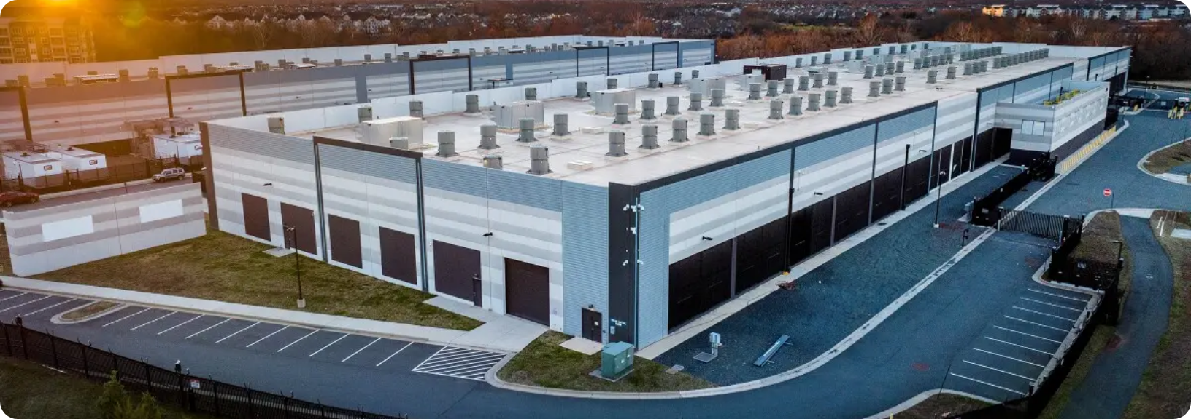








AWS Data Centers
AWS data centers are the physical facilities that house the computing, storage, and networking infrastructure that powers AWS cloud services.
Physical Security Layers
Perimeter Layer
Security guards, fencing, and intrusion detection
Key Features
Infrastructure Layer
Global Distribution
Secure building design, backup power, HVAC systems, and fire suppression
Hundreds of data centers spread across the globe, organized into Regions and Availability Zones
Data Layer
Redundant Systems
Strict access controls and threat detection for customer data
Equipped with redundant power systems, cooling, and network connections to ensure continuous operation
Environmental Controls
Advanced systems maintain optimal operating conditions for hardware

Slide 5















Choosing an AWS Region
Selecting the optimal AWS Region balances technical requirements with business objectives to ensure performance, compliance, and cost-effectiveness.
Compliance & Data Residency
Latency & User Experience
Primary consideration for regulated data
Choose Region close to primary user base
Ensure data remains within geographic boundaries
Reduced latency improves application performance
Review local laws and compliance requirements
Enhances communication quality and user satisfaction
Cost Optimization
Service Availability
Service pricing varies across Regions
New services deploy to specific Regions first
Evaluate costs for different deployment options
Ensure Region supports all required services
Use AWS Pricing Calculator for comparison
Consider future service expansion needs
1. Identify Business Requirements
2. Evaluate Technical Needs
3. Compare Regions
4. Select Optimal Region

Slide 6





Slide 7













Question 1
AWS Region
What is the primary relationship between an AWS Region and an Availability Zone (AZ)?
AZ-1
AZ-2
A
An AZ is a separate geographic area from a Region.
B
A Region is a single data center, and an AZ is a server within that data center.
Each Region consists of multiple isolated Availability Zones
C
An AZ is one or more discrete data centers within an AWS Region.
D
Regions and AZs are interchangeable terms for the same concept.

Slide 8










AWS Region
Correct Answer: C
An AZ is one or more discrete data centers within an AWS Region.
AZ-1
AZ-2
Explanation:
AZ-3
An Availability Zone (AZ) is one or more discrete data centers with redundant power, networking, and connectivity within an AWS Region.
Each AWS Region consists of a minimum of three, isolated, and physically separate Availability Zones (AZs).
A Region is a physical location, while an AZ is a logical grouping of data centers
Key Points:
AZs are designed to be isolated from each other
Each AZ has independent power, networking, and connectivity

Slide 9





Question 2
What is the minimum number of Availability Zones required in an AWS Region?
Answer Options:
A
1
B
2
C
3
D
4

Slide 10










Answer 2
Correct Answer: C) 3
AWS Region with 3 Availability Zones
Each AWS Region consists of a minimum of three, isolated, and physically separate Availability Zones.
AWS Region
Why is this important?
AZ-1
AZ-2
AZ-3
Enables fault tolerance and high availability for applications
us-east-1a
us-east-1b
us-east-1c
Design allows customers to build highly available applications
Physical separation of AZs ensures continued operation

Slide 11















Question 3
AWS Region
What is the main purpose of having multiple Availability Zones within an AWS Region?
AZ-1
AZ-2
A
To reduce data transfer costs between services.
AZ-3
AZ-4
To provide isolated locations for deploying applications to achieve higher availability and fault tolerance.
B
Multiple AZs provide fault tolerance and high availability
C
To allow customers to choose their preferred data center provider.
D
To enable faster content delivery to end-users globally.

Slide 12














Correct Answer: B
To provide isolated locations for deploying applications to achieve higher availability and fault tolerance.
AZ-1
AZ-2
AZ-3
Explanation:
Availability Zones give customers the ability to operate production applications and databases that are more highly available, fault tolerant, and scalable than would be possible from a single data center.
AWS Region
Multiple AZs provide protection against:
Power outages
Lightning strikes
Deploying applications across multiple Availability Zones is a core best practice for achieving high availability and fault tolerance. This design protects applications from failures that might affect a single data center.
Tornadoes
Earthquakes

Slide 13


Slide 14






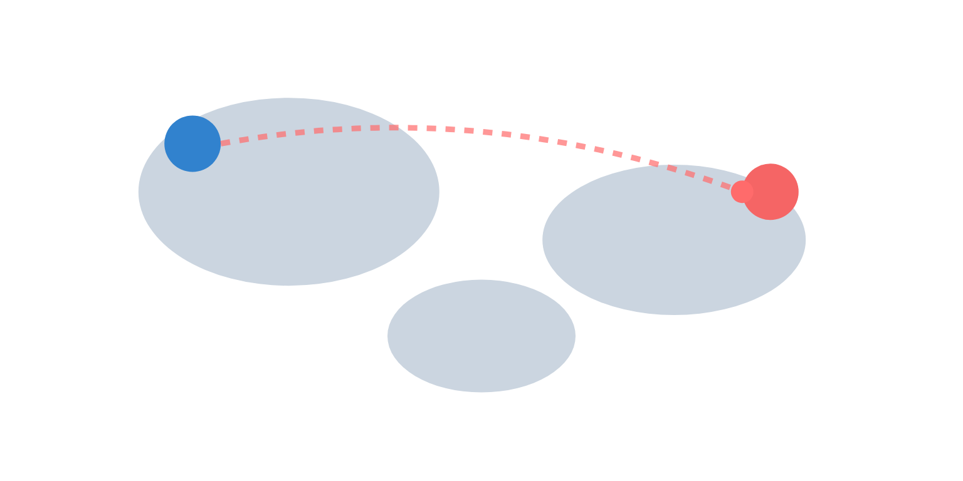




Why AWS Edge Locations?
Addressing latency for global digital experiences
The Global Latency Challenge
How Data Travels Across the Globe
Physical distance creates network latency
Centralized clouds face performance bottlenecks globally
Impact on user experience and business metrics
Latency Impact:
Fast
Slow
User
Data Center
Latency
"What if content could travel 200 times faster to users worldwide?"

Slide 15










Edge Locations & CDN
AWS Edge Locations form a global network of Points of Presence that power Amazon CloudFront (CDN), reducing latency by caching content closer to end-users and enhancing application performance worldwide.
AWS Edge Network
Amazon CloudFront (CDN)
Strategically distributed Points of Presence (PoPs) worldwide
Content Delivery Network service that leverages Edge Locations
Bring AWS services closer to end-users
Securely delivers static and dynamic web content, video streams, and APIs
Reduce latency by caching content geographically nearer to users
Enables efficient global content delivery
Enhance security with integrated AWS Shield and WAF
Minimizes distance data travels, resulting in faster load times
Improved Performance
Enhanced Security
Global Reach
Reduced latency and faster content delivery
First line of defense against threats
Efficient content delivery worldwide

Slide 16
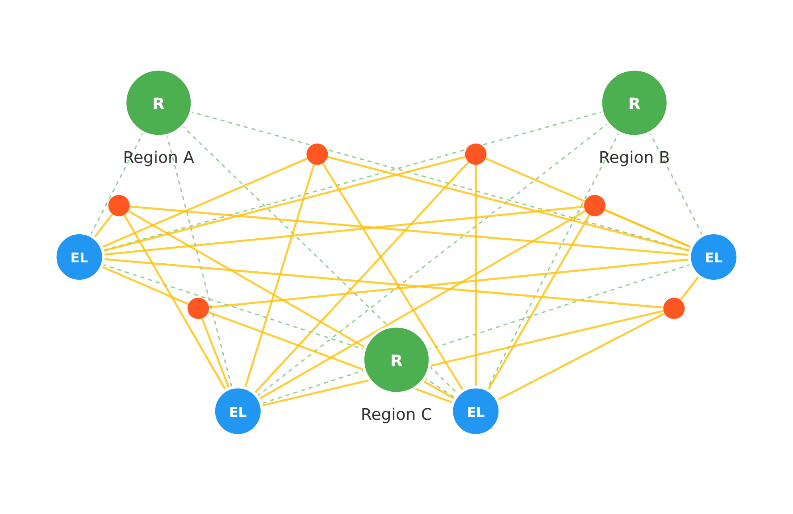

Explaining AWS Edge Locations
Delivering Content Faster and More Securely to Your Users

Slide 18
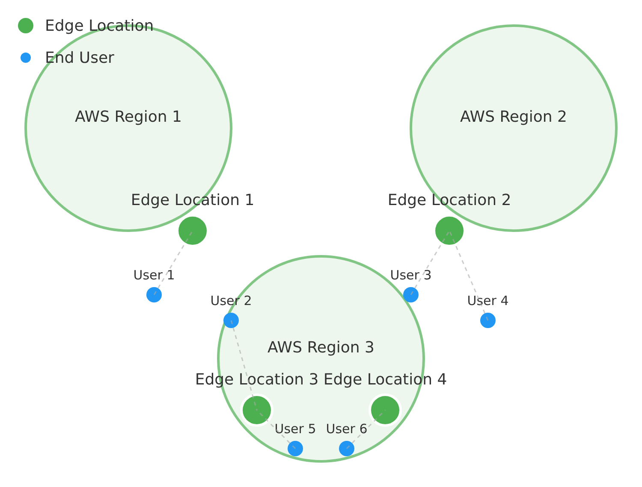



Question 1
Which AWS Global Infrastructure component is primarily designed for caching content closer to end-users to reduce latency for content delivery?
A
AWS Region
B
Availability Zone
C
Edge Location
D
Local Zone
Edge Locations improve performance by bringing content closer to users

Slide 19










C
Edge Location
Explanation:
Edge Locations are strategically positioned worldwide to cache static and dynamic content, such as web pages, images, and videos, closer to end-users. Services like Amazon CloudFront leverage these locations to deliver content with minimal latency, improving user experience by reducing the distance data needs to travel.
Key Point: Edge Locations are specifically designed for content delivery caching, distinct from Regions and Availability Zones.
Global Content Delivery
Reduced Latency
Improved Security

Slide 20
























Question 2
Which AWS service heavily utilizes Edge Locations to improve performance and reduce latency for global users?
A
Amazon EC2
EC2
B
Amazon S3
CloudFront
C
Amazon CloudFront
S3
Edge Locations
RDS
D
Amazon RDS
Amazon CloudFront uses Edge Locations to cache content globally, reducing latency for users

Slide 21









Correct Answer: C. Amazon CloudFront
Amazon CloudFront is the AWS service that heavily utilizes Edge Locations to improve performance and reduce latency for global users.
Explanation:
Amazon CloudFront is a content delivery network (CDN) service that uses AWS Edge Locations to cache content and deliver it to users with low latency.
When a user requests content served by CloudFront, the request is routed to the nearest Edge Location, which then serves the content from its cache, significantly speeding up delivery.
While Amazon EC2, S3, and RDS are core services primarily hosted within Regions and Availability Zones, S3 can integrate with CloudFront for content delivery.

Slide 22

















Stay Connected with Our Cloud Computing Journey!
Dive deeper into the cloud world! Check out our specialized playlists for your continuous learning journey!
Like this video if you found it helpful!
Subscribe for cloud tech updates!
Comment below which cloud topic you want to see next like:
Cloud Security Tips
Cost Optimization Strategies
Multi-Cloud Management
Serverless Computing
Cloud Migration Steps
Anything you'd like 🙂

Slide 23

















Local Zones
What are Local Zones?
Primary Use Cases
AWS Local Zones extend an AWS Region by placing compute, storage, database, and other select AWS services closer to large population and industry centers.
Real-time Gaming
Providing responsive and immersive gaming experiences by reducing lag
Live Video Streaming
Delivering high-resolution video and audio with minimal buffering and latency
AWS Region
Single-digit millisecond latency
Located closer to users
Augmented & Virtual Reality
Supporting interactive AR/VR applications that require immediate feedback
Key Benefit
Enables ultra-low latency applications that would otherwise be impossible with standard AWS Regions, bringing computational power closer to the end-user.
Industrial IoT Applications
Processing data closer to the source for faster insights and control

Slide 24








Understanding AWS Local Zones
Extending AWS to metropolitan areas for ultra-low latency applications
Local Zone
Local Zone 1
Subset of AWS Services
Subset of AWS Services
Metropolitan Areas
AWS Region
Local Zone 2
Subset of AWS Services
Single-digit millisecond latency
Secure, high-bandwidth private network connection

Slide 26








Question 1
AWS Local Zones are designed to extend AWS infrastructure and services to what specific type of geographic area?
Downtown
A
Remote rural areas with limited connectivity
Midtown
B
Large metropolitan areas for latency-sensitive applications
Uptown
C
International waters for maritime operations
Large Metropolitan Area
Single-digit millisecond latency to end-users
D
High-security government facilities

Slide 27















Answer 1
B.
Large metropolitan areas for latency-sensitive applications
Explanation:
AWS Local Zones place compute, storage, database, and other select AWS services closer to large population, industry, and IT centers. This allows customers to run highly-demanding applications that require single-digit millisecond latencies to end-users.
Downtown
Industrial
Population
IT Center
Main AWS Region

Slide 28




Question 2
A company needs to deploy an application that requires single-digit millisecond latency for its users in a specific metropolitan area, but also needs to seamlessly connect to the full range of in-region AWS services. Which AWS infrastructure component is best suited for this requirement?
AWS Local Zones provide ultra-low latency to end-users
A
AWS Region
Connects seamlessly to all in-region services
B
Availability Zone
C
AWS Local Zone
D
AWS Wavelength Zone

Slide 29

















Answer 2
C
AWS Local Zone
Explanation:
AWS Local Zones are designed to place compute, storage, database, and other select AWS services closer to end-users in large metropolitan areas, providing single-digit millisecond latencies while maintaining connection to the parent AWS Region.
AWS Region
LZ 1
City 2
City 4
City 1
LZ 2
City 5
LZ 3
City 3

Slide 31


